Slide 1
AP Stat Exam 2022

Slide 2
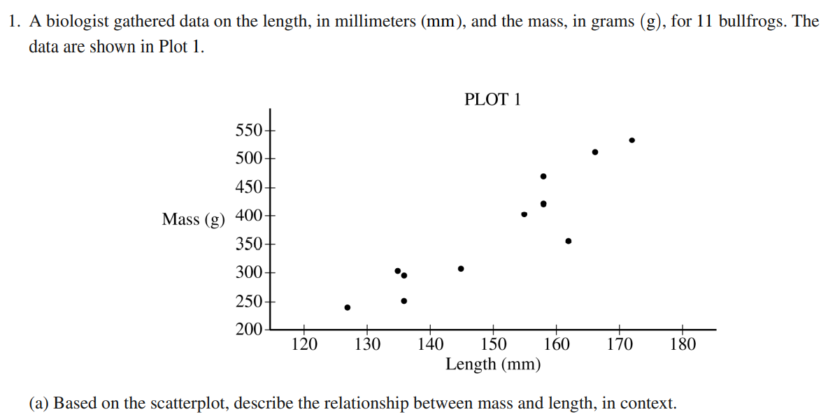
The scatterplot of Length (mm) and Mass (g) of the 11 bullfrogs is positive, linear, strong with no apparent outliers.

Slide 3
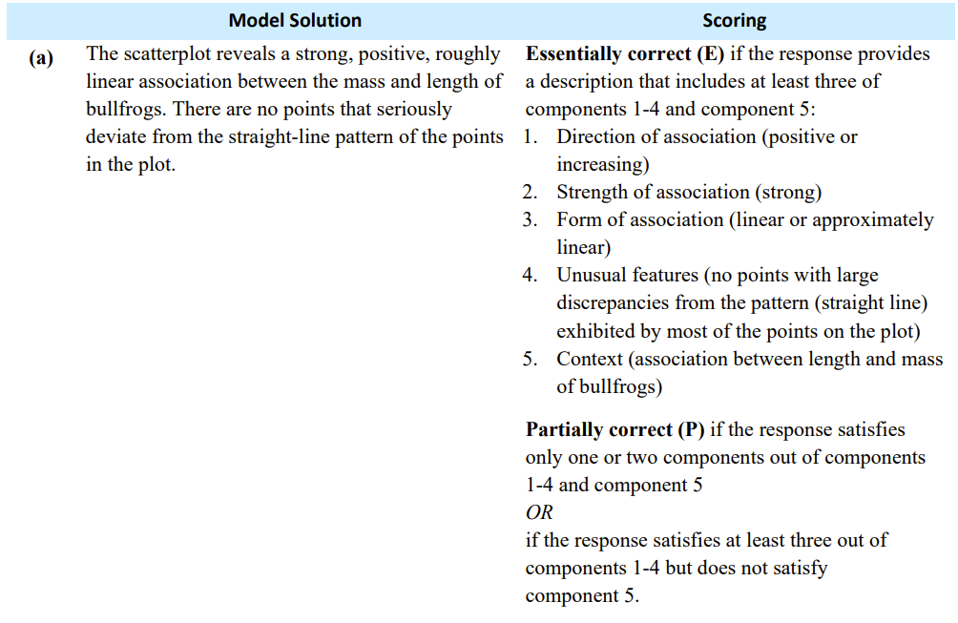

Slide 5
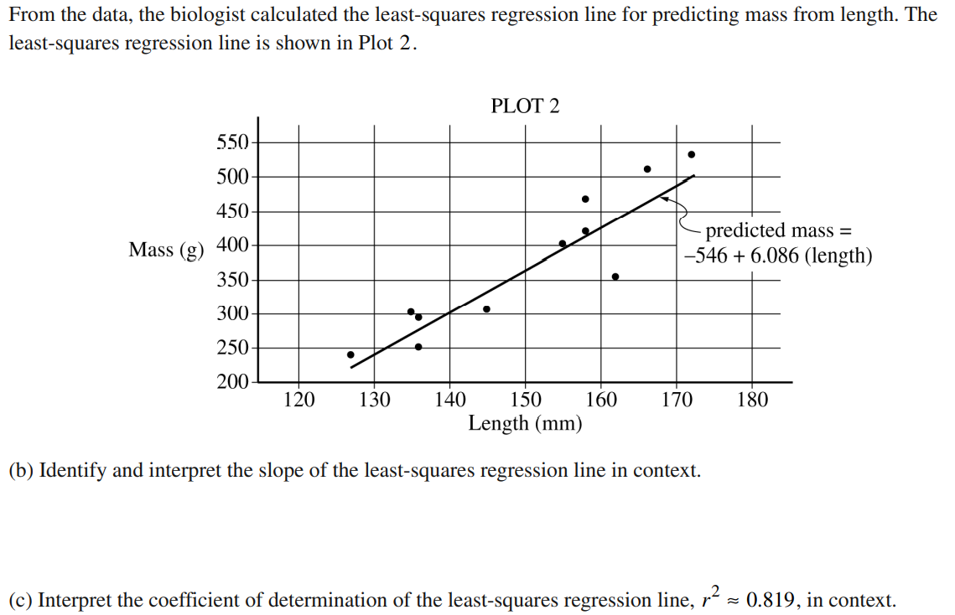
On average, for every increase of 1 mm in the length of the bullfrog there tends to be an increase of 6.086 g in the mass.

Slide 6
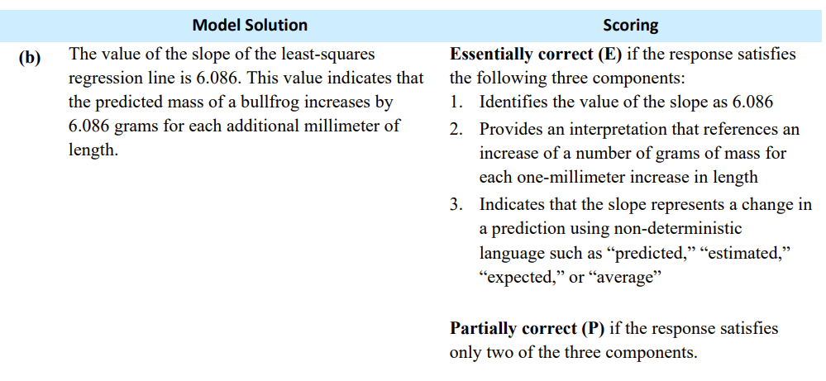

Slide 8
In this model, 81.9% of the variations in the mass can explained by variations in the length

Slide 10
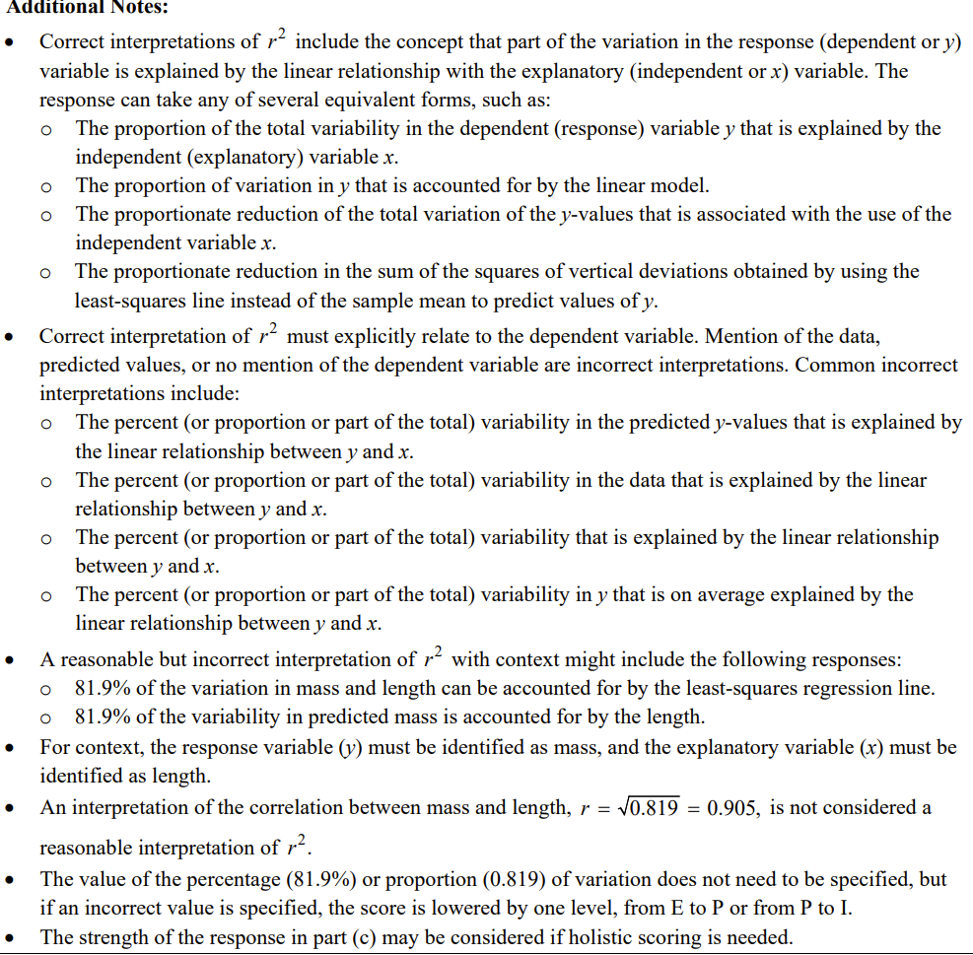

Slide 11
Around 162 mm and 355 g
The point lies below the line so the regression line would overestimate the mass of the bullfrog

Slide 12
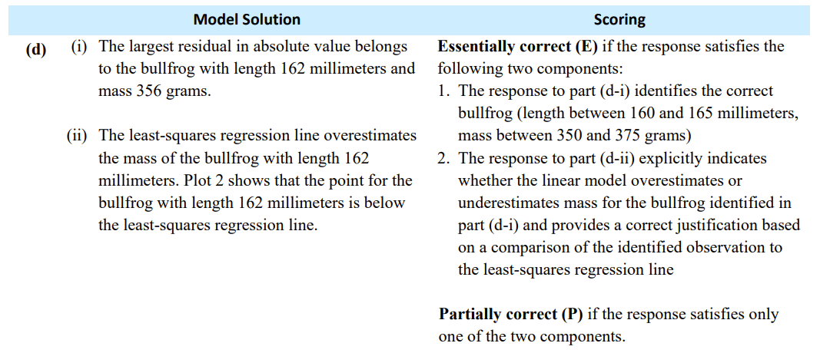

Slide 13
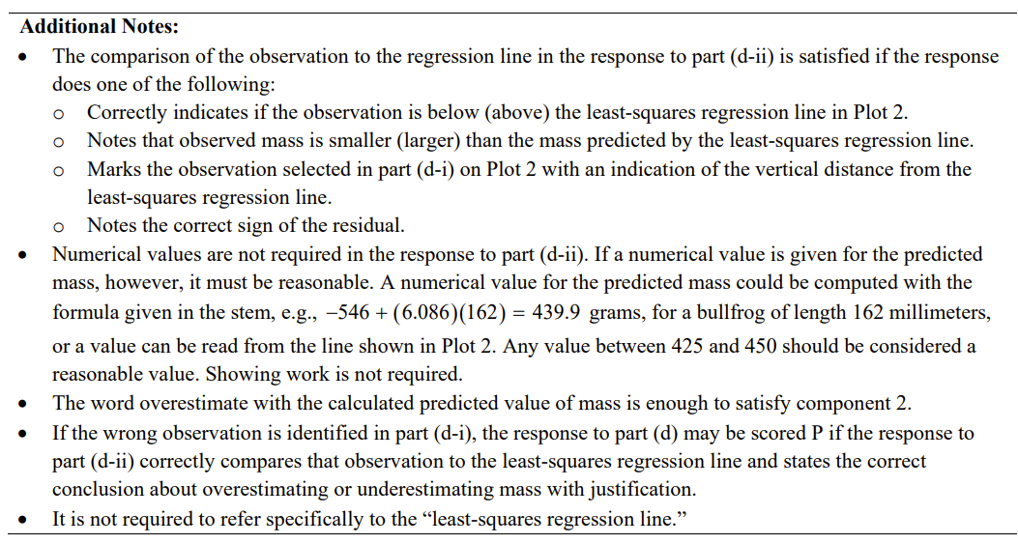

Slide 14
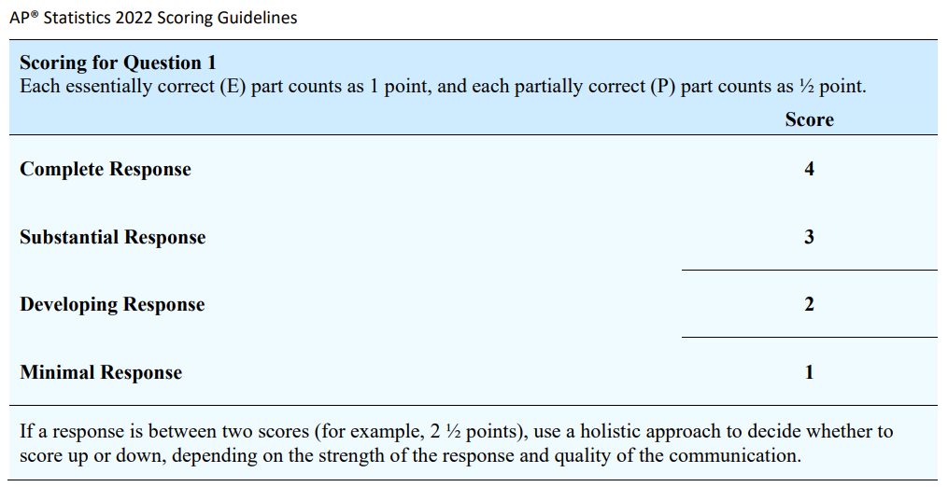

Slide 15
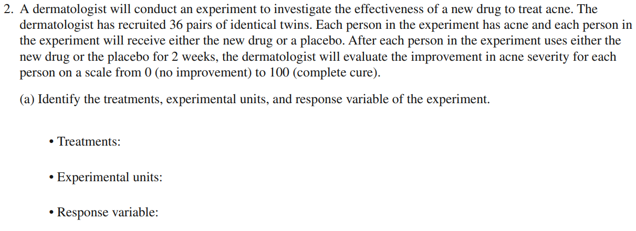
2 Treatments: New Drug and Placebo
36 sets of identical twins, 72 total subjects
Improvement in acne severity on a scale from 0 (no improvement) to 100 (complete cure)

Slide 16
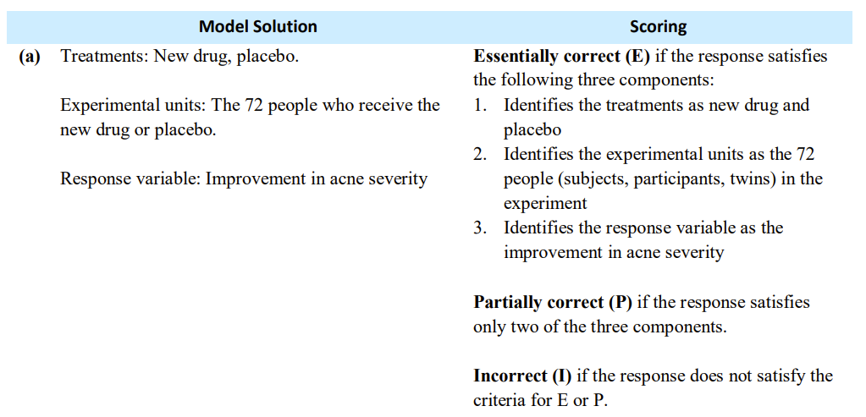

Slide 17
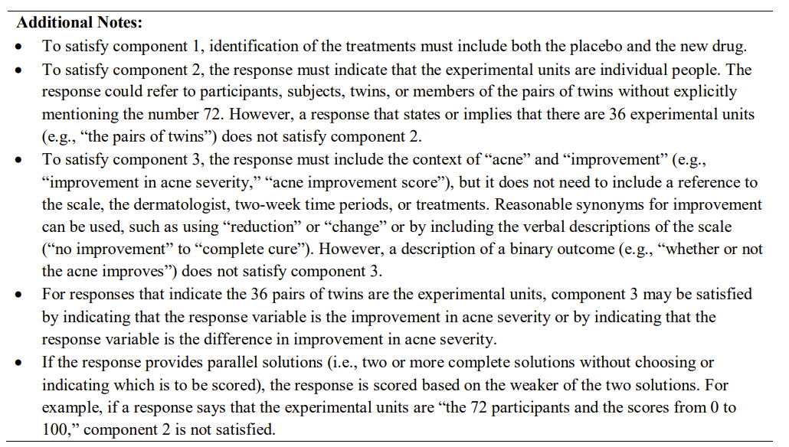

Slide 18
Severity of acne differs from twin pair to another, but the identical twins should have about the same severity of acne.
Pairing the twins would allow for a reduction in the variation of severity of acne, so that it is not a confounding variable. Therefore, the variation in results (acne severity improvement) that is observed is more likely to be due to the treatments, and not a confounding variable.
With a completely randomized design, the results could be due to the variations in the severity of the initial acne, and not due to the treatments.

Slide 19
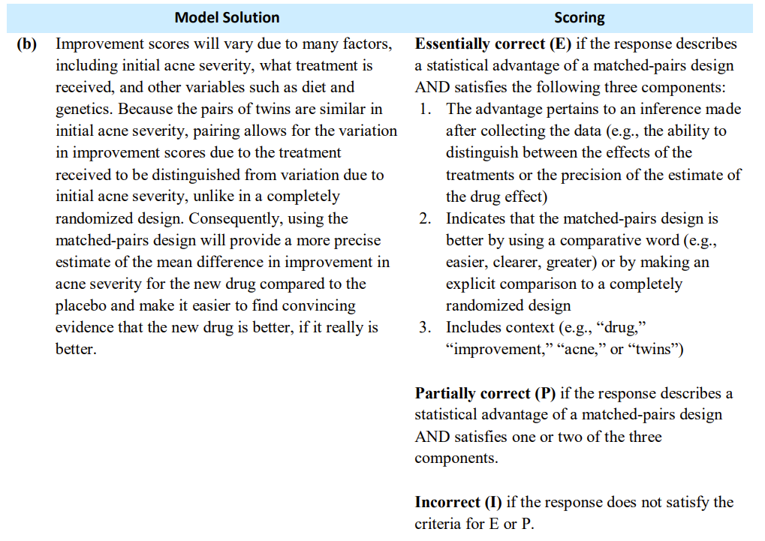

Slide 20
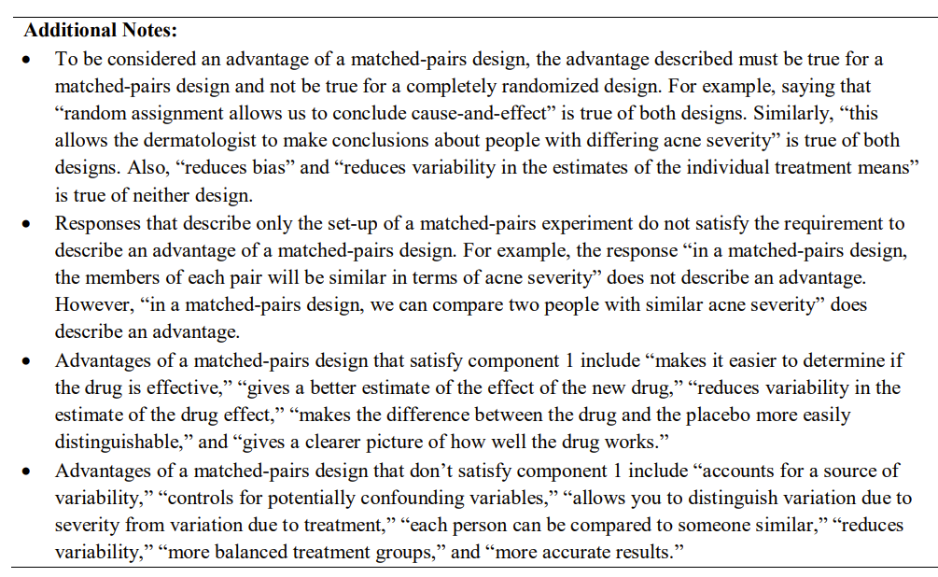

Slide 21
Assign each twin as an even number or odd number.
Use a table of random digits.
Read off 1 number. That twin would be assigned the new drug. Assign the second twin in the placebo group.
Continue until all pairs are complete and all twins are assigned a treatment.

Slide 22
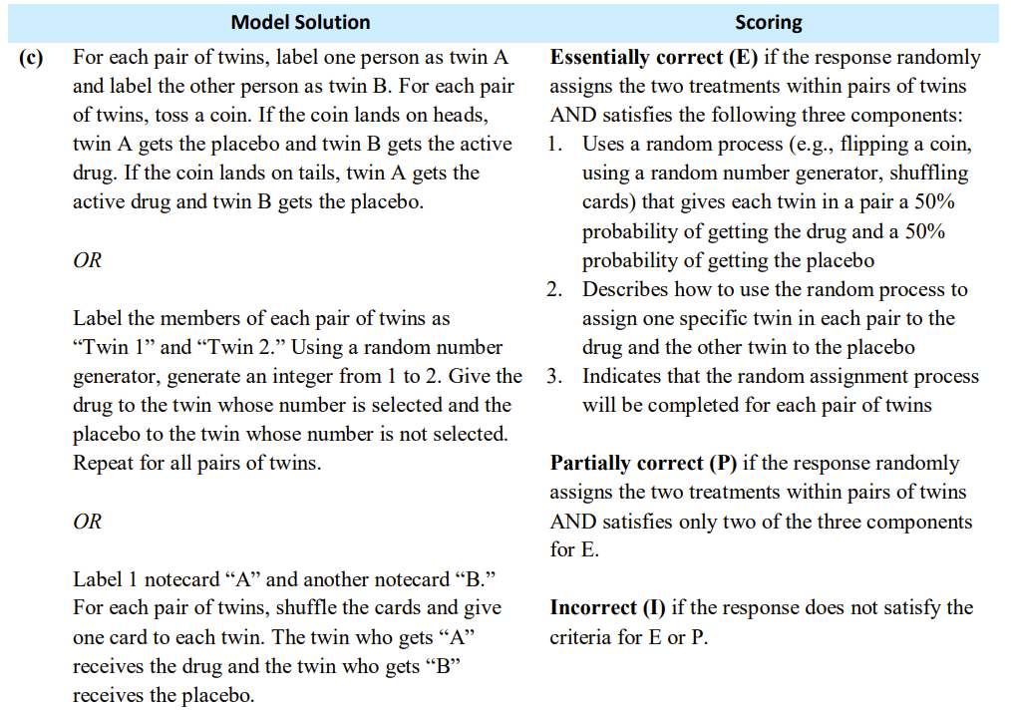

Slide 23
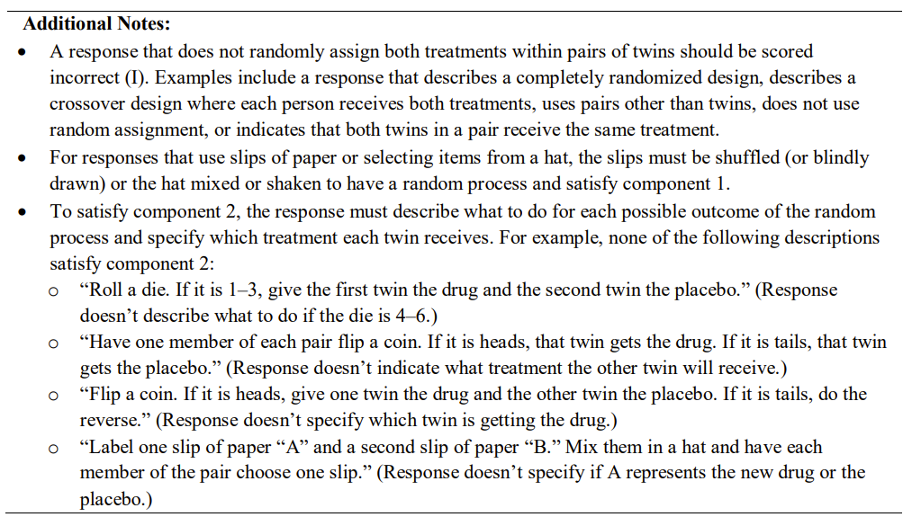

Slide 24
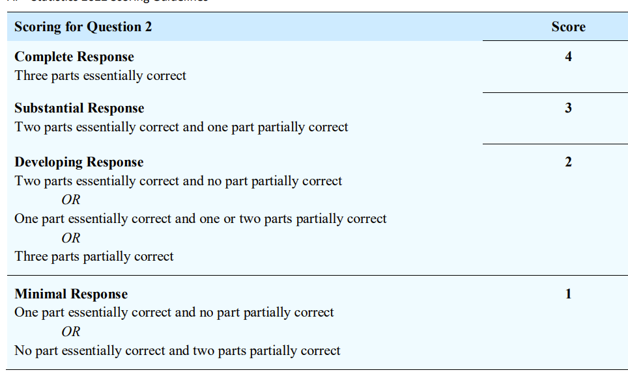

Slide 25
$$A\sim N\left(0.60,0.04\right)$$
$$P\left(A<0.50\right)=0.0062$$

Slide 26
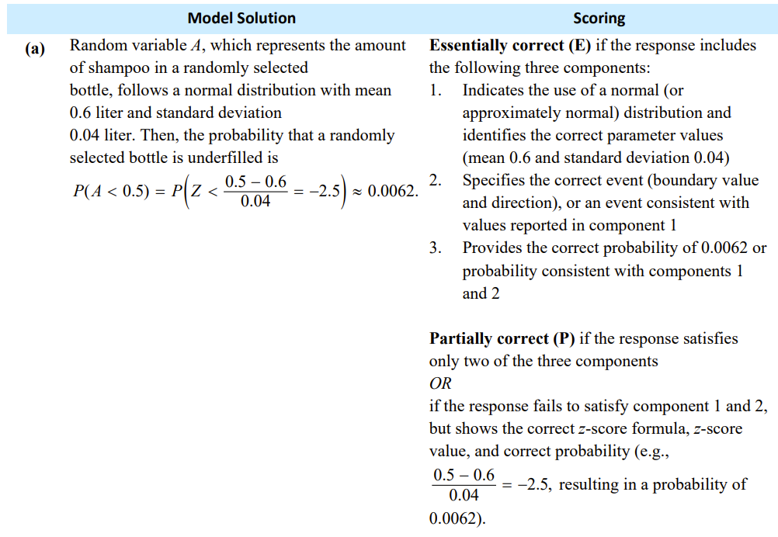

Slide 27
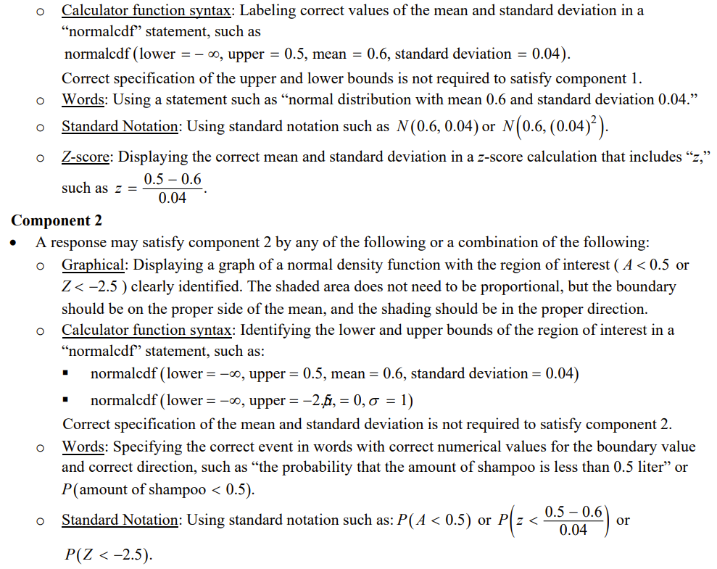

Slide 29
X = Number of underfilled bottles
$$X\sim Binomial\left(10,0.0062\right)$$
$$P\left(X≥2\right)=0.0017$$

Slide 30
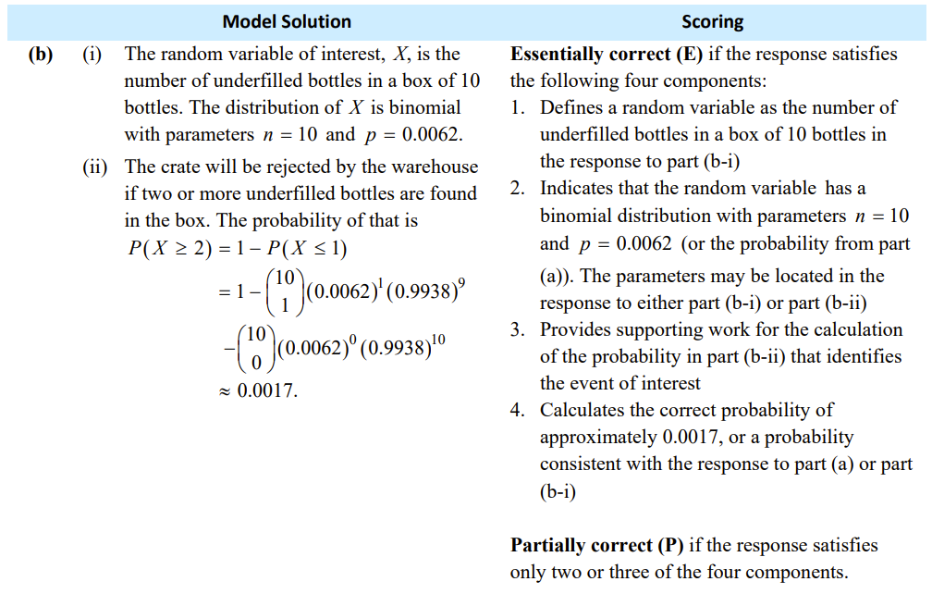

Slide 31
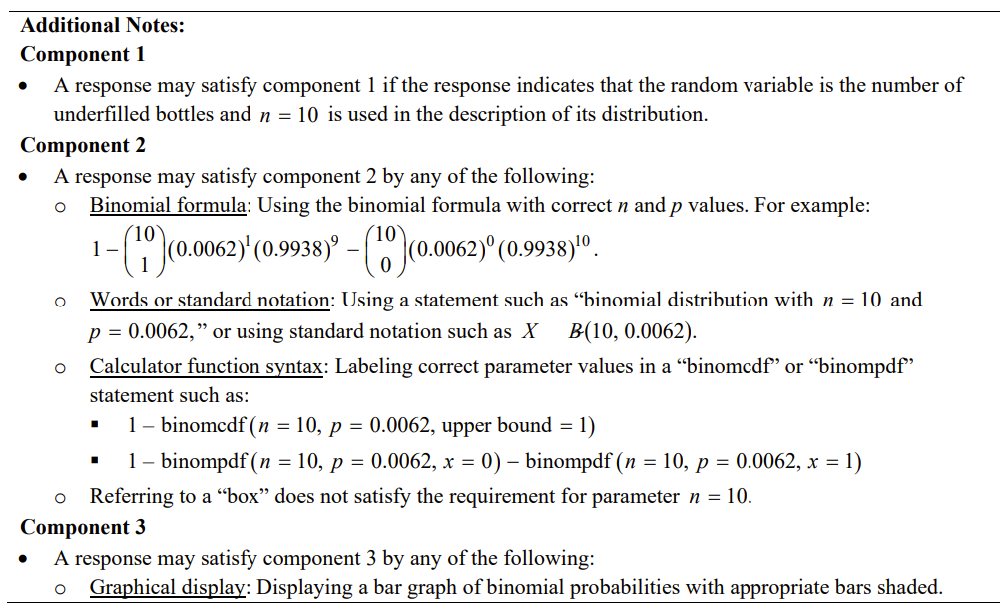

Slide 32
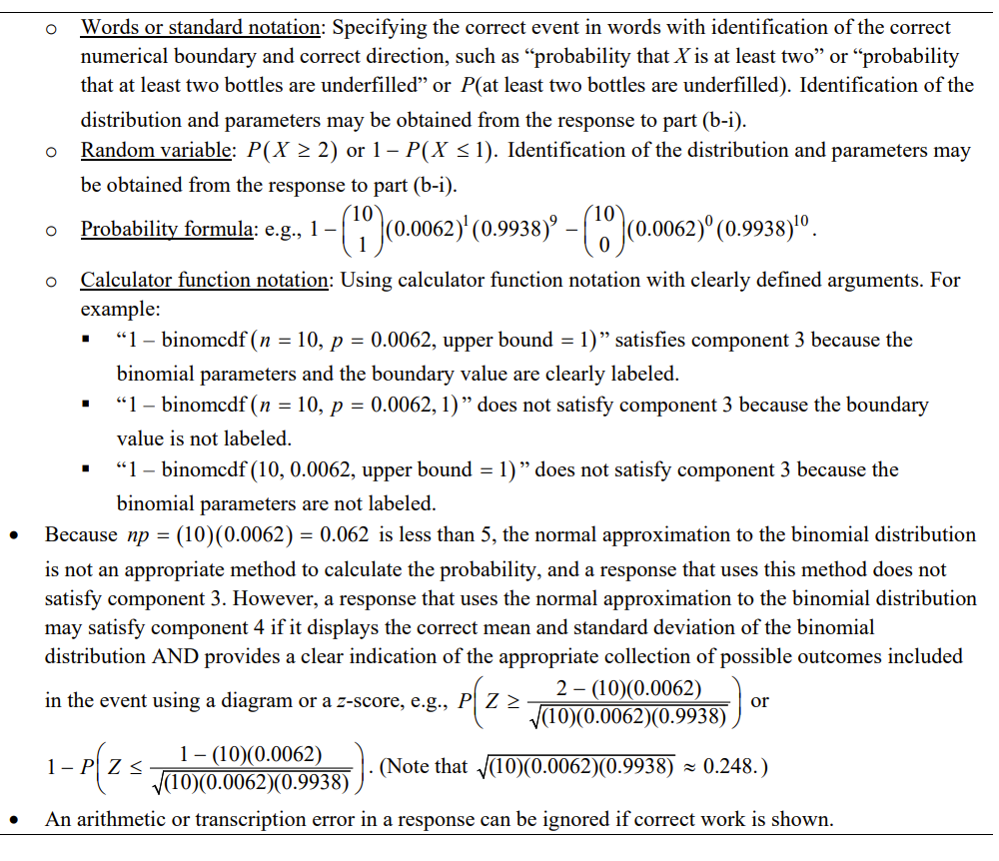

Slide 33
$$B\sim N\left(0.56,0.03\right)$$
$$P\left(B<0.50\right)=0.0228$$
X = Number of underfilled bottles
$$X\sim Binomial\left(10,0.0228\right)$$
$$P\left(X≥2\right)=0.0207$$
Original programming:
$$A\sim N\left(0.60,0.04\right)$$
$$P\left(A<0.50\right)=0.0062$$
X = Number of underfilled bottles
$X\sim Binomial\left(10,0.0062\right)$
$P\left(X≥2\right)=0.0017$
I would recommend using the original programming as the probability that any given bottle is underfilled much less than the adjusted program. So, the probability that the crate would be rejected is also higher.

Slide 34
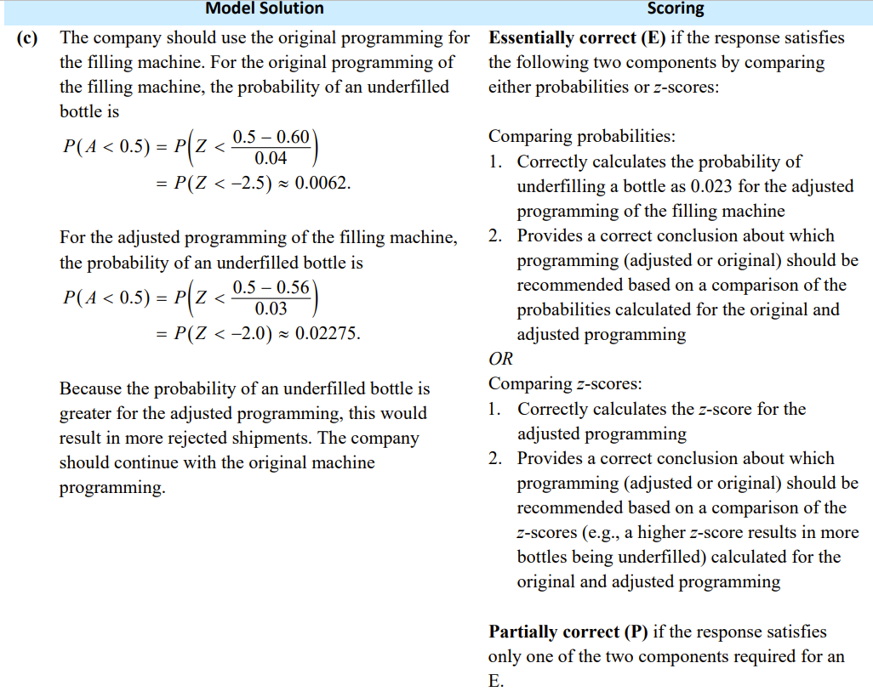

Slide 35
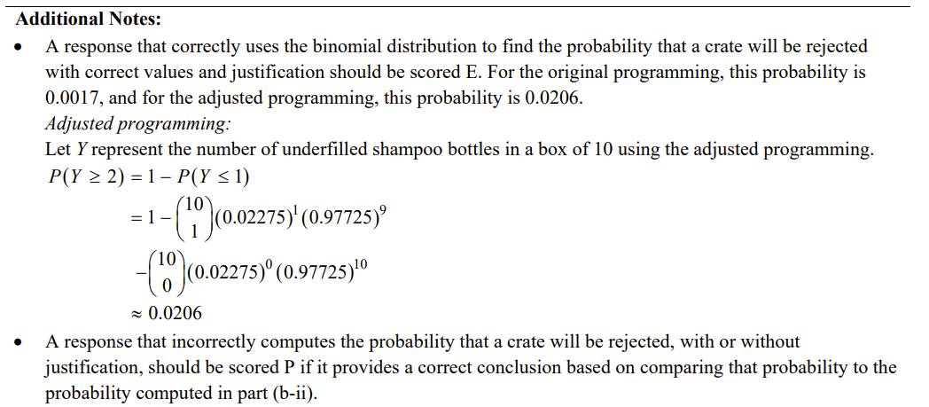

Slide 36
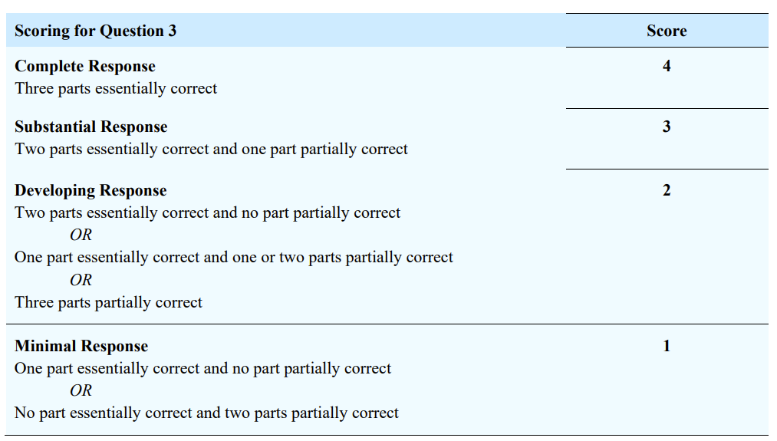

Slide 37
1. Random: Stated as a random sample
2. 10% Condition: 920 is less than 10% of all teenagers in the United States
3. Success/Failure:
All conditions have been met for a 1 proportion z-interval.
$$n\hat{p}=543≥10$$
$$n\hat{q}=377≥10$$
$0.59±1.96\sqrt{\frac{\left(0.59\right)\left(0.41\right)}{920}}$ = (0.558, 0.622)
We are 95% confident that the true proportion of teenagers that use a video streaming service lies between 55.8% and 62.2%.

Slide 38
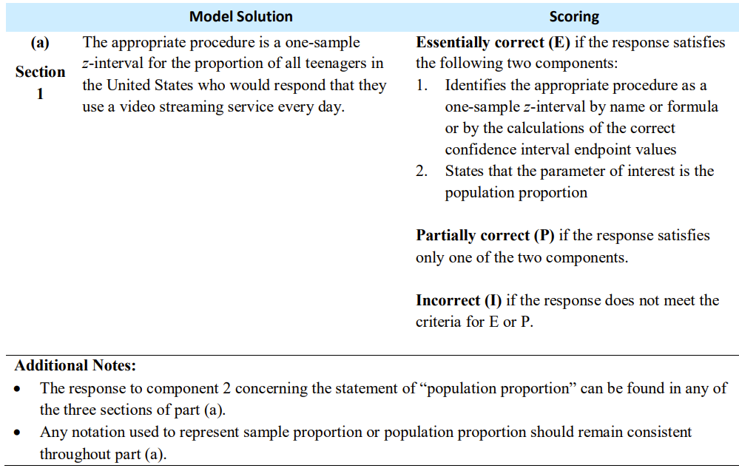

Slide 39
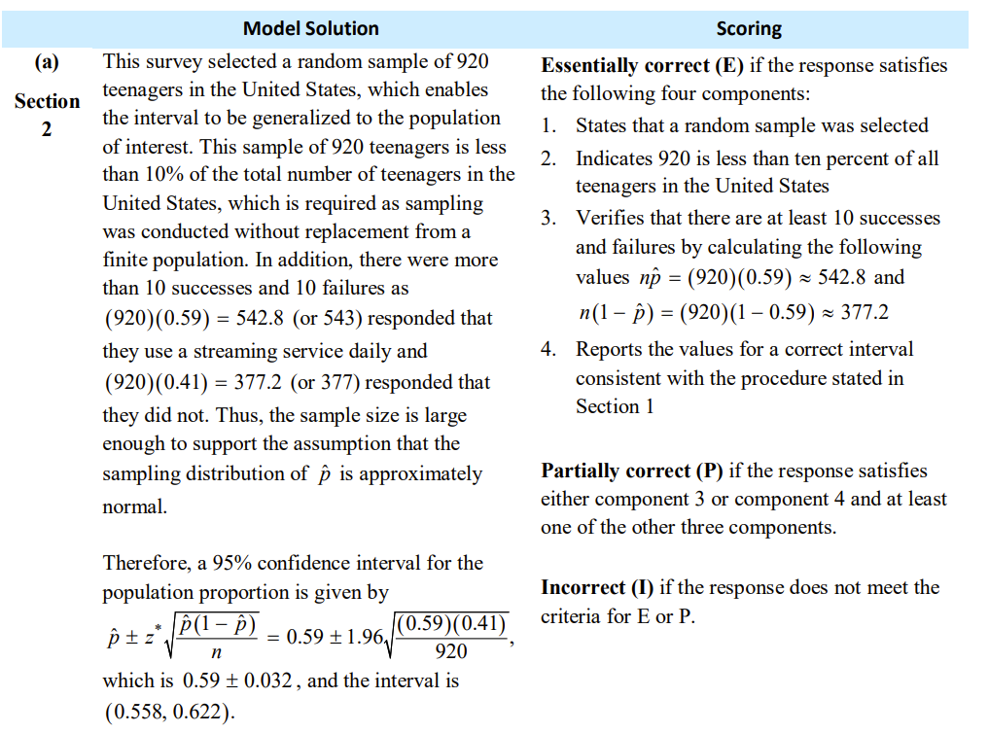

Slide 40
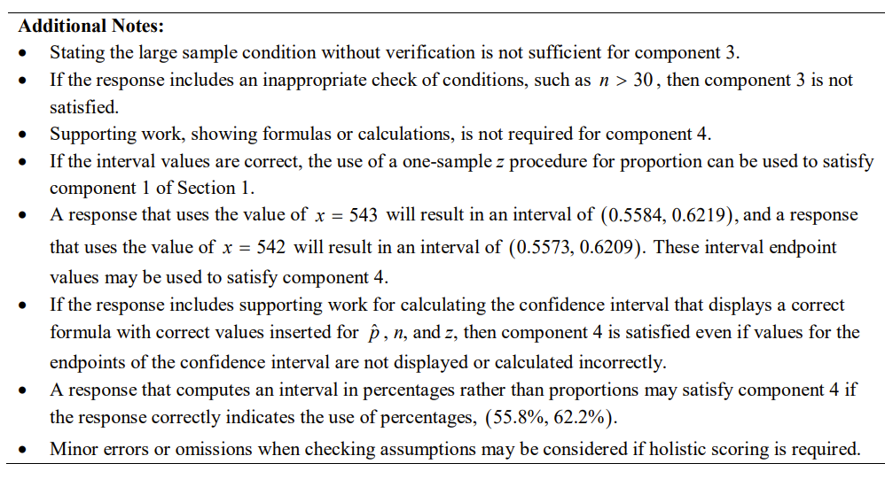

Slide 41
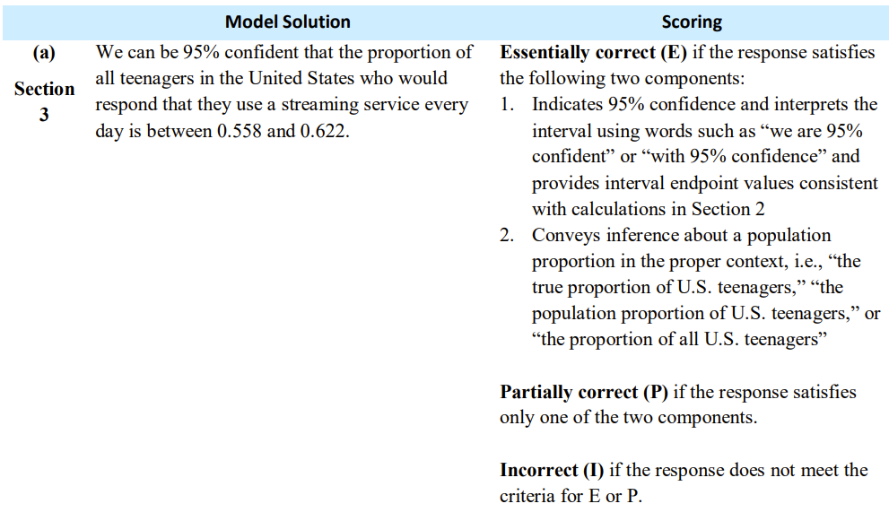

Slide 42
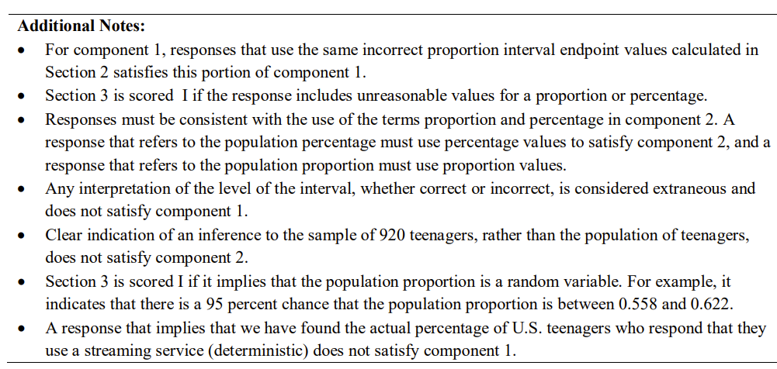

Slide 43
(0.558, 0.622)
Since 0.5 is not within the interval created, we can say there is statistically significant evidence that the proportion of all teenagers in the United States who would respond that they use a video streaming service is not 0.5.

Slide 44
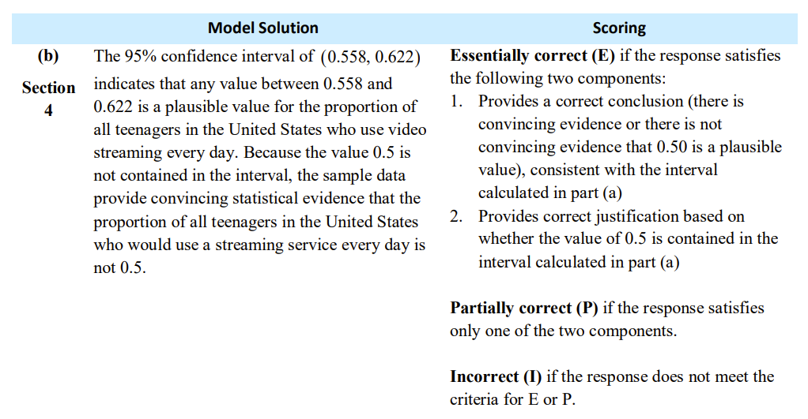

Slide 45
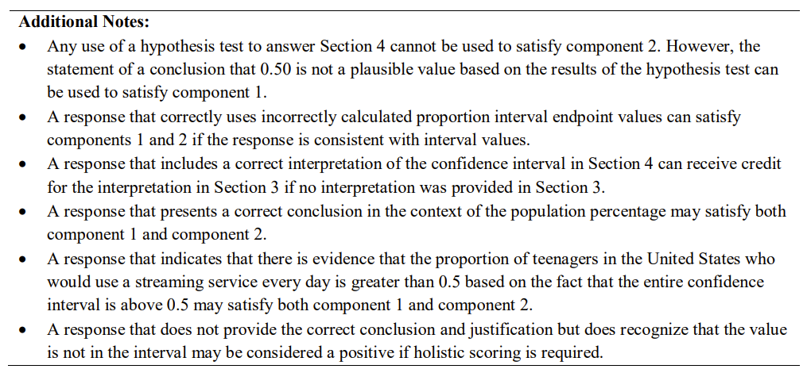

Slide 46
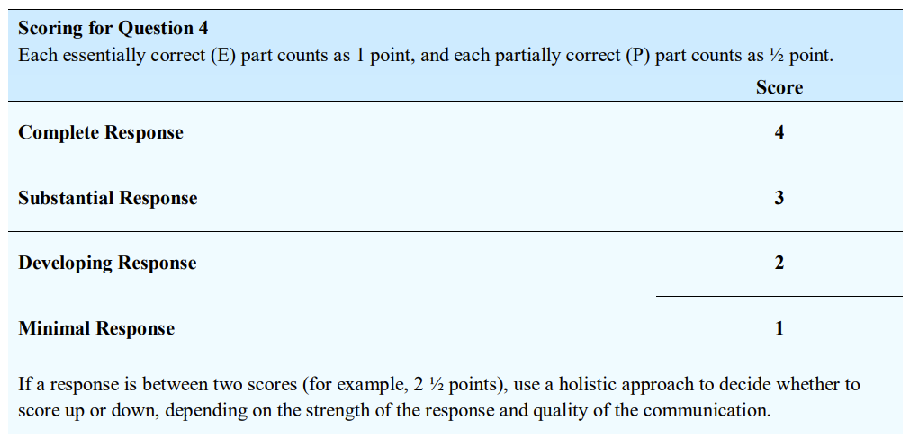

Slide 47
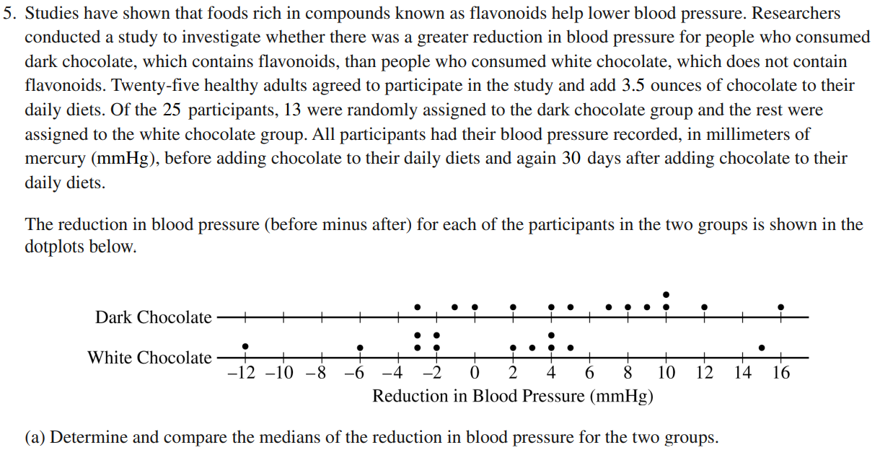
The median reduction in blood pressure for the Dark Chocolate group is 7 mmHg which is higher than the median for the White Chocolate group of 0 mmHg.

Slide 48
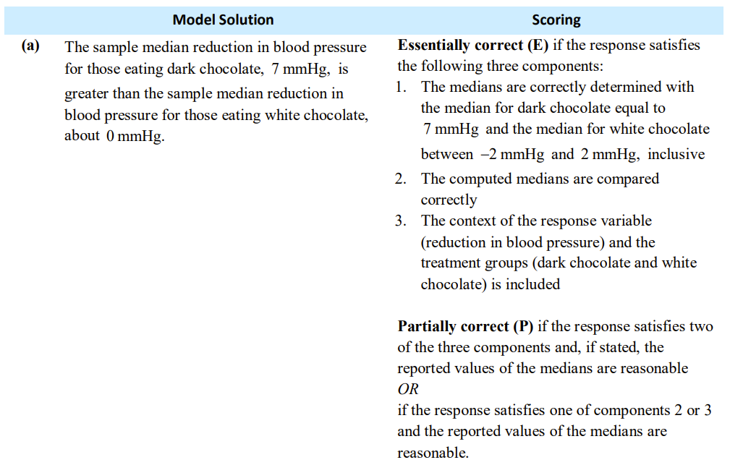

Slide 50
The standard deviations are not included in the comparison so we can’t tell if the difference of 5.66 is really that much larger than 0. We can’t tell if the difference of 5.66 could just happen by random variation or if it is a statistically significant difference.

Slide 51
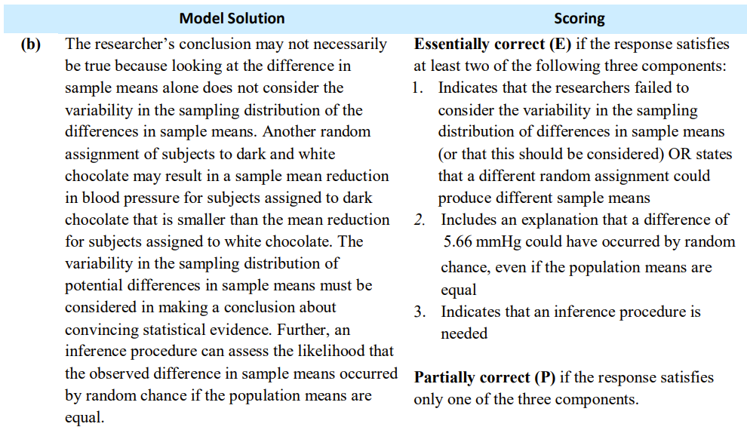

Slide 53
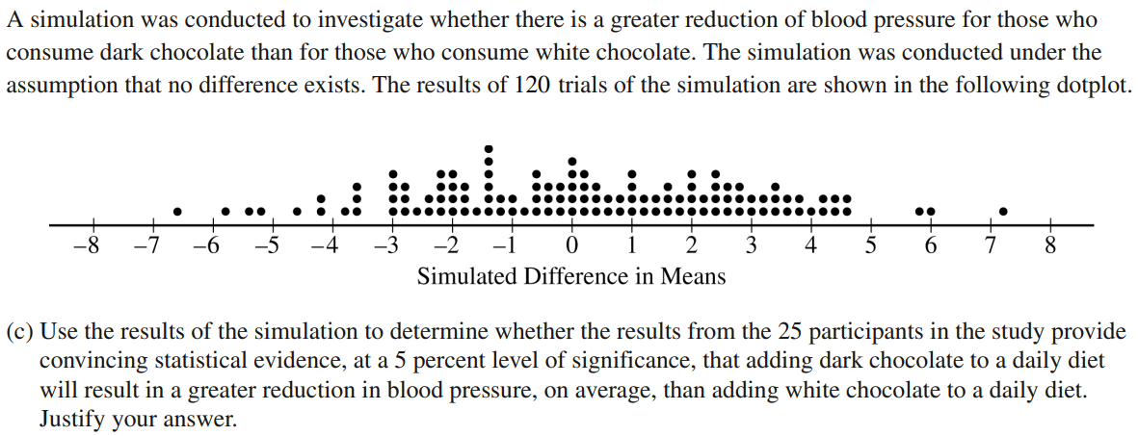
The difference found between the samples was 5.66. According to the results of the simulation there are only 3 trials that had a difference of 5.66 or one greater. The probability that it’s 5.66 or greater is 3/120 = 0.025. Since this value is less than 0.05 level of significance we reject the null hypothesis. There is statistically significant evidence that the difference in means between the reduction in blood pressure of the dark chocolate group is higher than the white chocolate group.

Slide 54
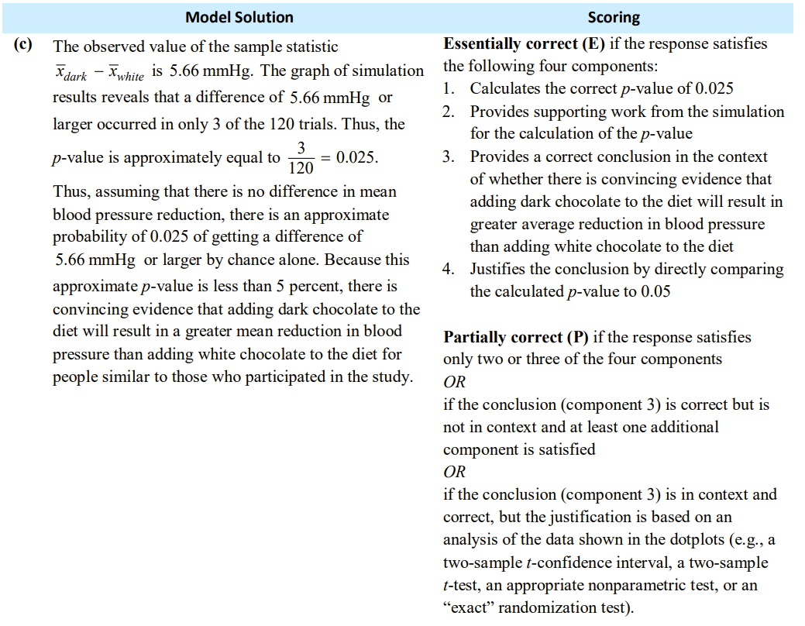

Slide 56
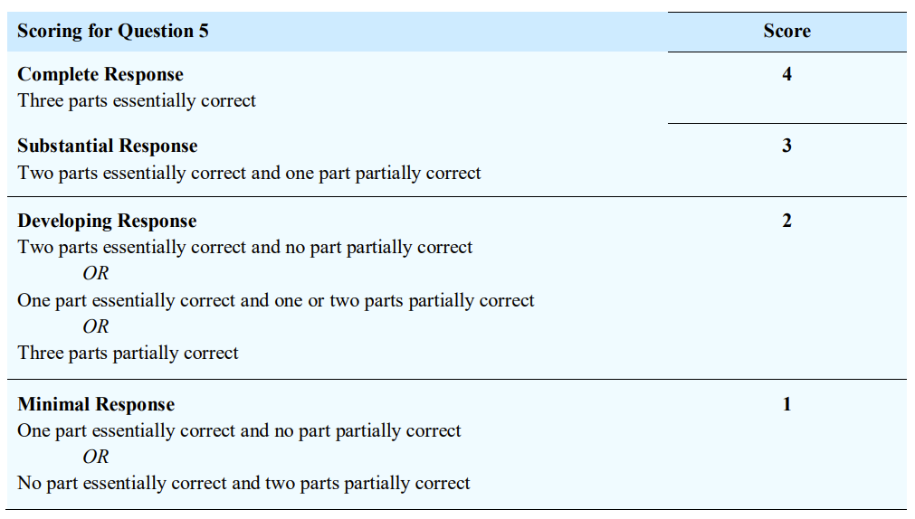

Slide 57
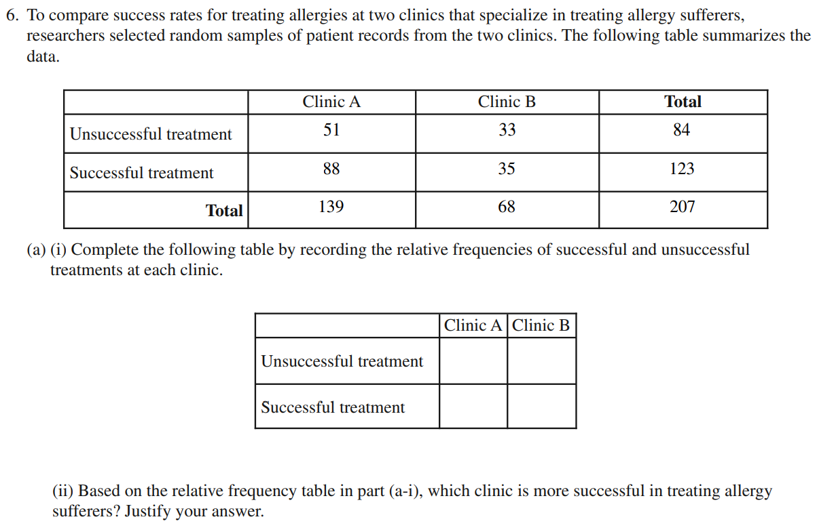
0.367
0.485
0.633
0.515
It appears that Clinic A has a higher success rate of 63.3% than Clinic B with a success rate of 51.5%

Slide 58
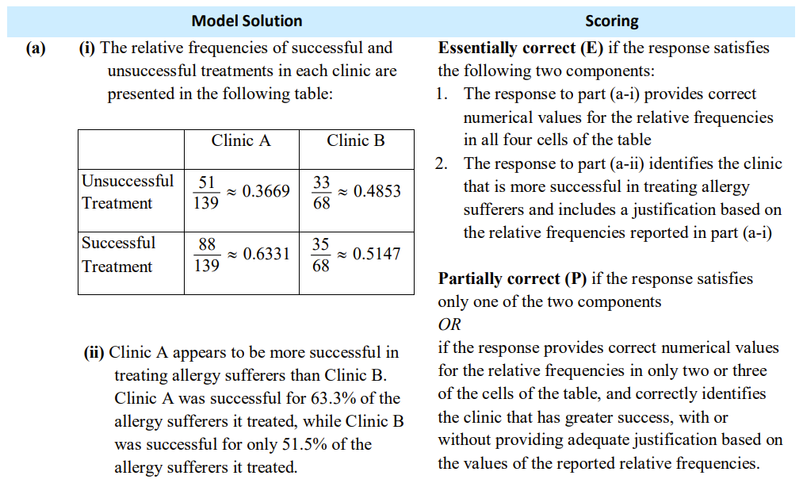

Slide 59
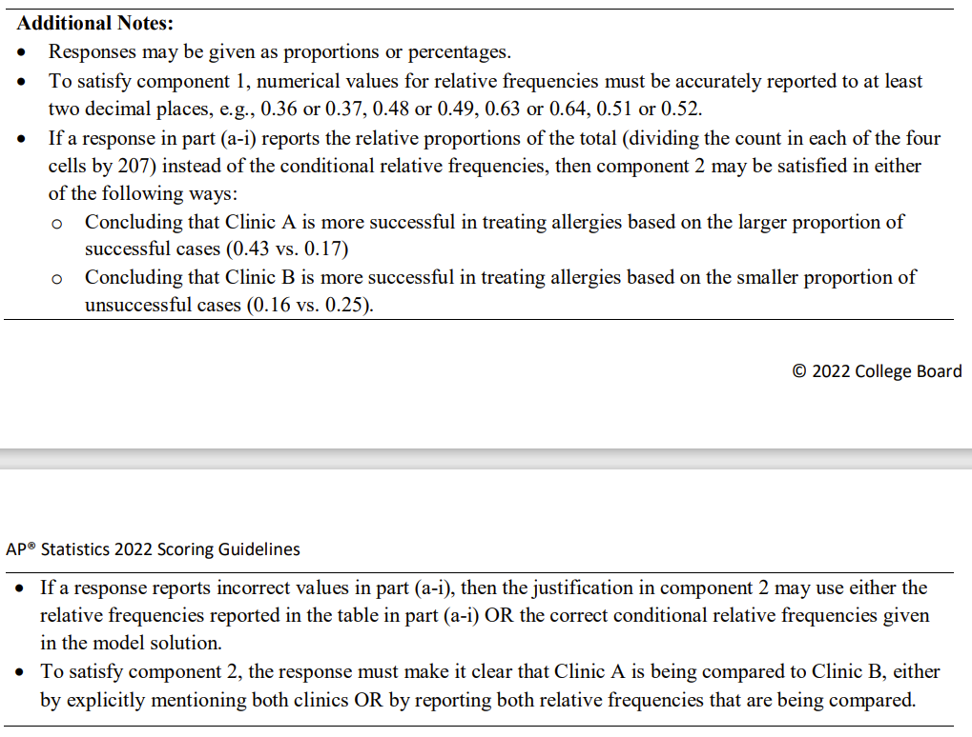

Slide 60
No. The study was not a controlled experiment where individuals were randomly placed into treatment groups.

Slide 61
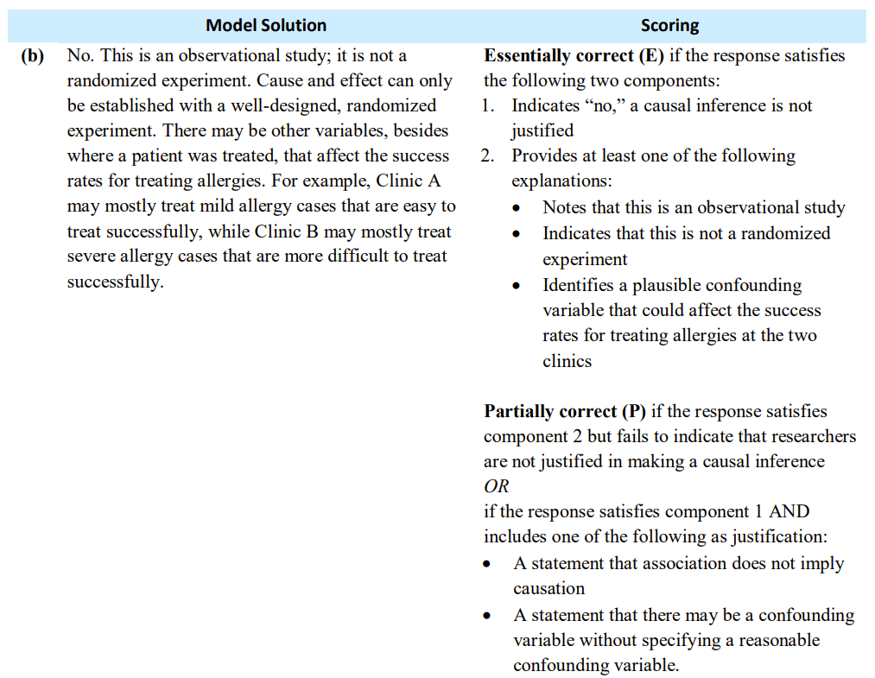

Slide 63
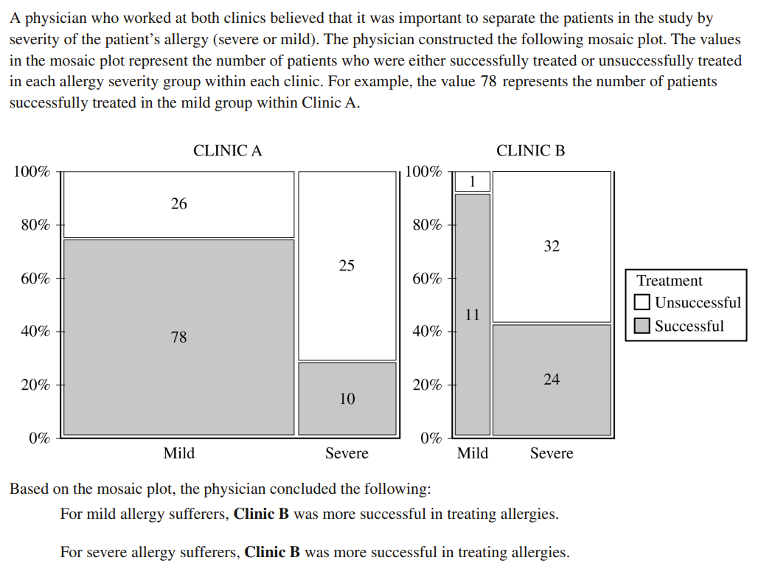

Slide 64
$$Mild​​\frac{78}{104}=0.75Severe\frac{10}{35}=0.286$$
$$Mild​​\frac{11}{12}=0.917Severe\frac{24}{56}=0.429$$
Clinic B had higher success rate for Mild with 91.7% compared to Clinic A with a success rate of 75%
Clinic B had higher success rate for Severe with 42.9% compared to Clinic A with a success rate of 28.6%

Slide 65
$$Mild​​\frac{104}{139}=0.748Severe\frac{35}{139}=0.252$$
$$Mild​​\frac{12}{68}=0.176Severe\frac{56}{68}=0.824$$

Slide 66
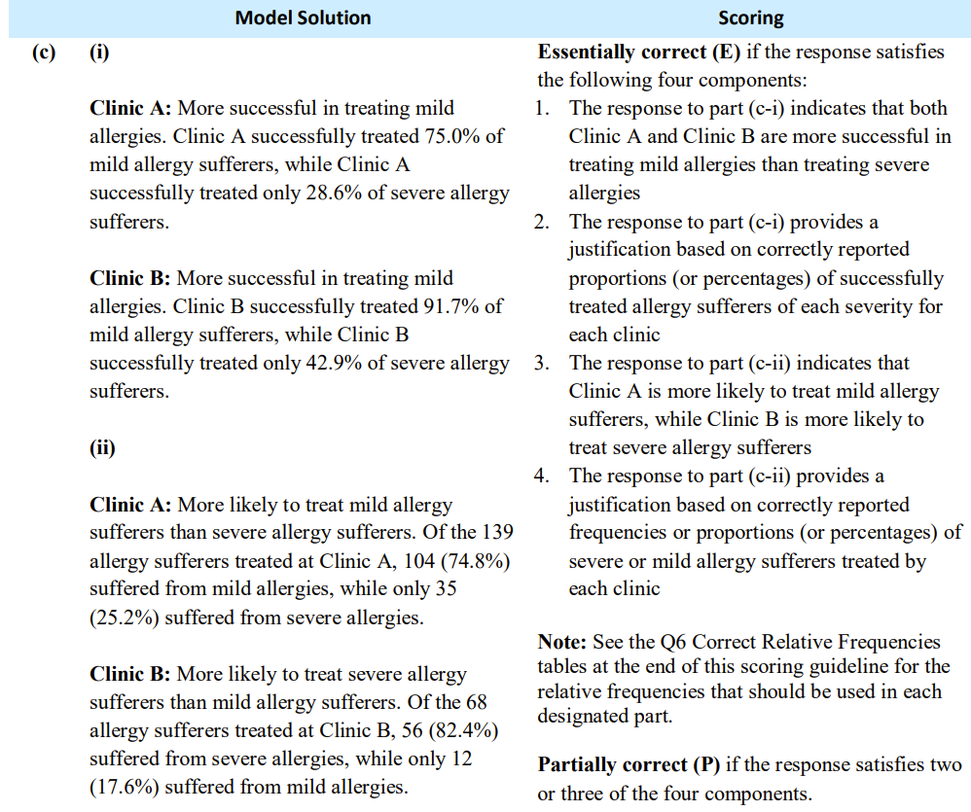

Slide 67
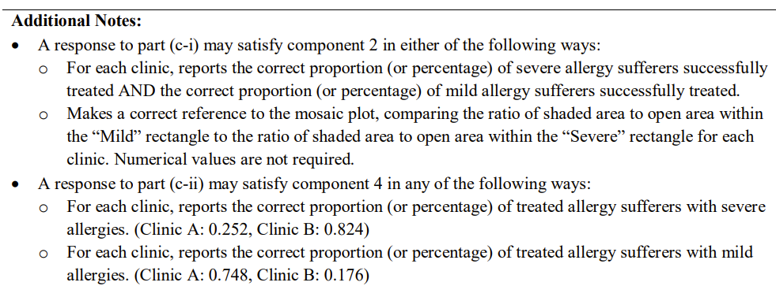

Slide 68
It appears that the physician’s conclusion for Clinic B being more successful is correct.
Clinic B had higher success rates than Clinic A in both Mild (91.7% vs 75%) and Severe (42.9% vs 28.6%).
It appears that in both clinics, Mild has a higher success rate than severe. Clinic A treated Mild cases at a much higher rate than Clinic B (74.8% compared to 17.6%). So that makes Clinic A’s overall success rate higher than Clinic B’s.

Slide 69
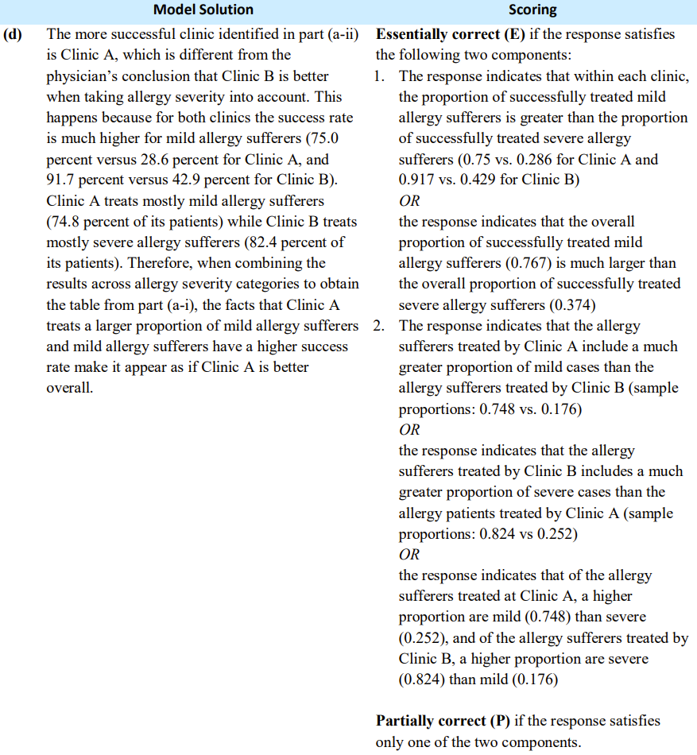

Slide 70
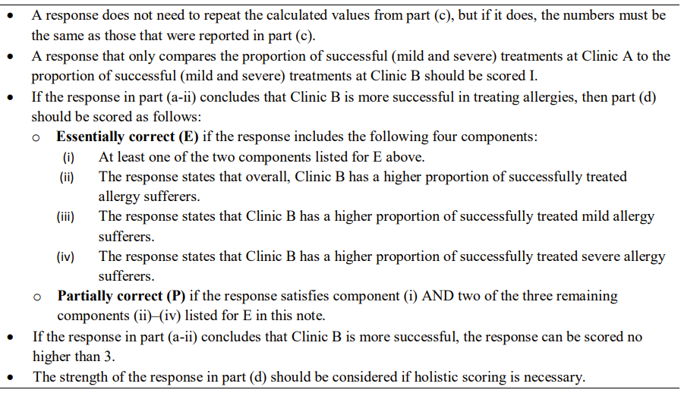

Slide 71
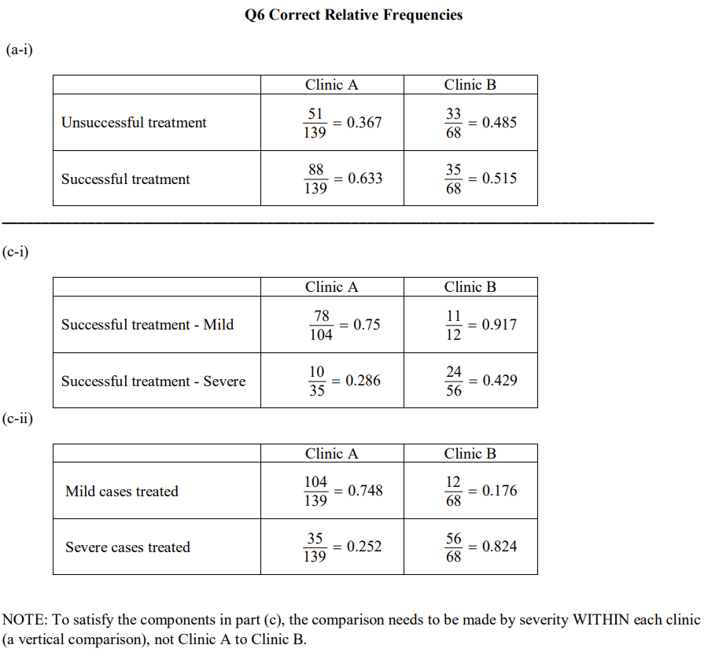

Slide 72
